Slide 1

What could be happening here?
Who has the power in this relationship?
How can you tell?

Slide 2
L.O.
Create and sustain dramatic roles (AF3 S&L)
6 - Make careful choices in speech, gesture, and movement
7 - Explore complex ideas and issues
8 - Experiment with complex roles/scenarios

Slide 3
Proxemics
Body language
Tone of voice
Pace
Do you know what these key words mean?

Slide 4

What District are you from? What was life like before?
What chance do you think you have of winning?
How did you feel when your name was selected?
What sets you apart from the crowd?
Last lesson you created a character who will be a part of the latest Hunger Games.
You are going to be completing a speaking and listening assessment which is an interview with Caesar Flickerman.

Slide 5
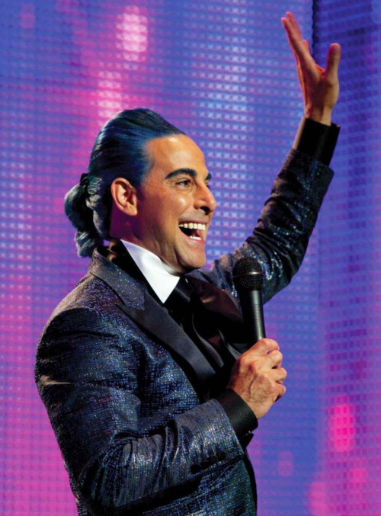
Unfortunately, Caesar Flickerman will not be available to do the interviews this year.
So, each District needs to nominate one person who will take on the role of interviewer.
You should choose someone who:
Has a calm and reassuring personality.
Is confident and can win over the audience.
Can think of some fantastic questions to get the most out of each interviewee.

Slide 6
6 - Make careful choices in speech, gesture, and movement
Language choices which your character might make.
Key facts about your character
Body language which will help you to show who your character is and how they will feel.
Speech choices which will help you to show who your character is and how they will feel.

Slide 7

7 - Explore complex ideas and issues
8 - Experiment with complex roles/scenarios
Is there any way you could incorporate some complexity into your role?
Could there be a secret romance that has been playing on your mind?
Are you out for revenge in the games?

